Slide 1

return yum!
Notes:
Hi everyone!
We are excited to present “Return Yum” as our week's project, which is also the MVP for an app focused on food waste awareness, saving money, and (in a bigger picture) promoting a sustainable future.
So in addition to three existing pillars of sustainability: recycling, reducing, and reusing, we now present 'Return' as a call for more responsible choices!

Slide 2
What does one orange mean?
return yum!
> 4.000.000
per week
> 320 tons
Mercury
80 gr.
Notes:
For starters, what does ONE orange mean?
In Portugal we have more than 4 million families and if in every home we throw away ONE single orange per week,
by the end of that week Portugal has wasted over 320 tons of oranges.

Slide 3
16.640
return yum!
In one year
tons of oranges
* According to Fundação Francisco Manuel dos Santos
And if 1,99€ per kg, well …
Notes:
Meaning that in one year we are wasting almost 17 thousand tons of “ “ “ JUST ONE Orange “ “ “
And if oranges cost 1,99 per kilogram, well you can do the math but…

Slide 4
Our Project
01. User input
03. Recipe options
02. Can we return yum?
04. Check your savings!
return yum!
What’s on your fridge turning bad?
Loop through delicious options!
Put food in a better place?
Give value to that number
Notes:
Our app is here to help!
“Return yum” allows the user to input ingredients that are on the verge of going bad,
then works its magic by suggesting recipes to make those ingredients shine in a better place.
In the end, not only helps to reduce food waste, but also allows the user to see the impact on their savings by not throwing food away.

Slide 5
01
Don’t snap on scrap(ing)
APIssues
return yum!
Name
Brand (customized)
Cost
Quantity
Documentation
Rate limits
Integration on script
Google trans
Notes:
TIAGO
we used 2 api’s and scrapped continente’s website. after the user inputs his leftovers, we get the prices and quantities of those products filtered by brand (Continente) in Continente’s website. one api is used to return the recipe’s name for those ingredients, the missing ingredients to able to cook that recipe and the recipe’s id. the second AP was get the recipe’s instructions according to the id that the first api gives us.
to make this all work we had to import pandas, requests, beautifulsoup, statistics and also regex to clean the dataframe to calculate the savings and google translate to translate the input to the apis because the website we scrapped is in portuguese and the api’s in english and we wanted to return everything simultaneously with only one input.

Slide 6

02
Recipe options
return
return yum!
Included ingredients
Missing ingredients
Instructions
Solution to problem
Notes:
TIAGO
the major challenges on this was to aggregate / integrate the information retrieved by web scrapping and both apis in the same dataframe / functions in a user friendly way,
it was laborous and time consuming and at some point we wanted to find databases / csv files about food waste so to clean and explore to give a deeper context to the subject but we didnt have time and even if we had we also didnt know how to fit that in a 5minute presentation, so we were very ambitious

Slide 7


03
Reaching the output
return yum!
We had dream…
… and dreams are challenging!
Notes:
TIAGO
and in the end the objective is to give a practical, meaningful and tasty solution to the problem presented in the beginning in a larger scale

Slide 8

04
Forking amazing!
return yum!
Saved ingredients
yum meal !
return savings!
Notes:
TIAGO
and in a smaller scale to save those leftovers, make a tasty meal and return savings so we hope you find this tool forking amazing

Slide 9
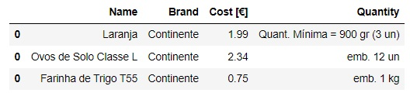

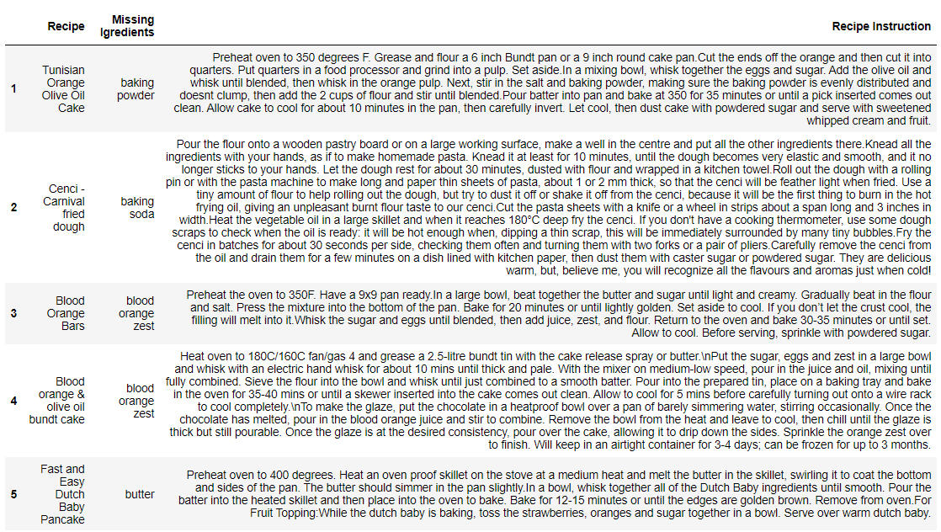


return yum!
return yum!
Notes:
Let’s have in mind that we are using price per KG, which will allows to compare also food waste in kg

Slide 10
return yum!
Thank y u!
Tiago
Mariko
Adriana

Slide 11
Upgrades on return yum!
Most frequent items
Donation system
Awareness for shopping list
Deliver waste back

